Slide 1
Fundamental Concepts

Slide 2
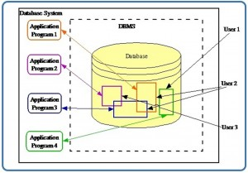
Database
The central idea of a database and DBMS is that instead of maintaining information in separate, isolated files, related data can be organized into a shared database that can be accessed by different users and applications.
What Is a Database?
A database is an organized, shared collection of related data created to support the activities of an organization.
Relational Database

Slide 3
This ability to organize information into multiple related tables is fundamental to the relational database model.
A relational database is a collection of related tables. In this example, the database contains the Employee and Department tables, which are related through DepartmentID.

Slide 4
What Is a Database Management System (DBMS)?
A database contains the related data.
A Database Management System (DBMS) is the software that manages the database.
A DBMS is a collection of programs that allows users and applications to create, maintain, retrieve, modify, and control access to a database.
Examples of DBMS software include MySQL, Microsoft SQL Server, Oracle Database, PostgreSQL, and SQLite.

Slide 5
Why Is a DBMS Called a "Collection of Programs"?
A DBMS performs many different tasks. It is therefore not simply one operation or command.
A DBMS includes software components responsible for activities such as:
Creating databases and tables
Storing data
Retrieving data
Updating and deleting data
Processing queries
Enforcing constraints
Managing Relationships
Controlling user access
Handling multiple users
Maintaining security
Managing transactions
Backup and recovery

Slide 6
When you execute:
SELECT *
FROM Employee;
you are giving an instruction to the DBMS. The DBMS interprets the SQL statement, determines how to retrieve the requested information, accesses the database, and returns the results.
This leads to an important distinction:
SQL is the language used to communicate with a relational DBMS. The DBMS is the software that actually manages the database.

Slide 7
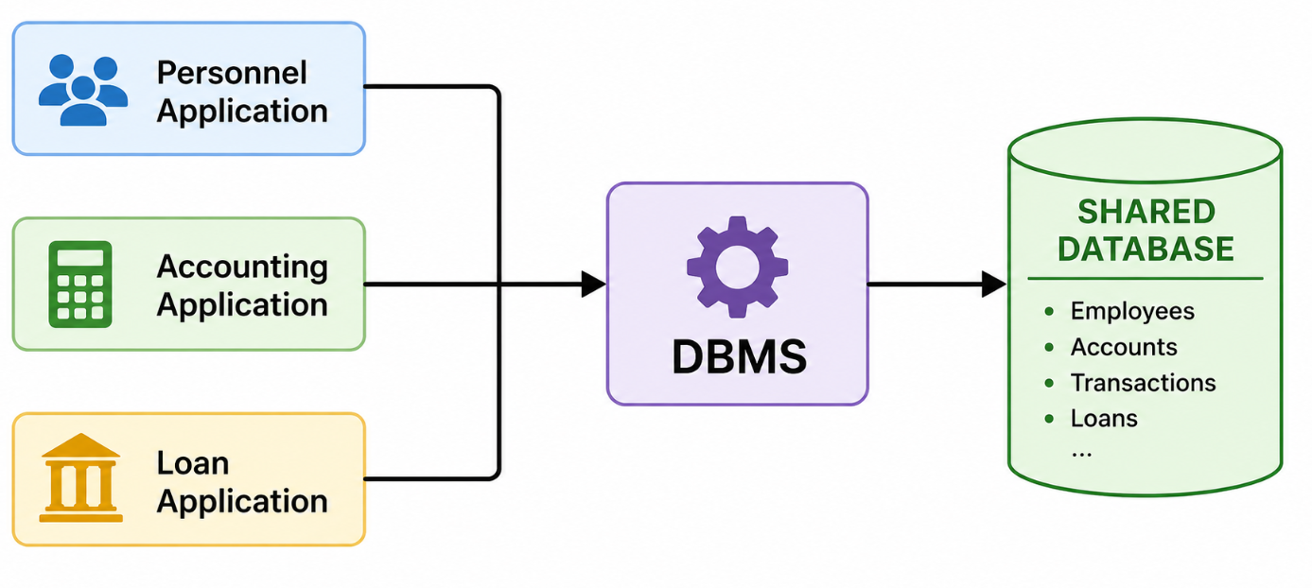
Database vs. DBMS vs. Application Program
Consider a banking system:
An employee in the Loan Department might use a loan-processing application.
The application communicates with the DBMS, and the DBMS accesses the database.
The teller does not necessarily interact directly with MySQL or write SQL commands. The application program can send the necessary requests to the DBMS on the user's behalf.
Different applications can therefore access the same shared database:

